Slide 1

Professional system in Québec

Slide 2

How is the System Organized
Why a Professional System
Evolution of Quebec case
OIQ

Slide 3

Attributes of a Professional
Skills – formalized education or training
Judgement – requires exercising discretion
Membership in self-governing associations
Contributes to public welfare

Slide 4
Professional System
System that governs actions of professionals
Professionals are members of professional associations
License is the permission to practice the profession according to rules.
Breaking rules can result in loss of license to practice

Slide 5
Professional Associations
Dedicated organizations that are governed by members of the profession.
Professional associations are institutionalized bodies
Social Contract Model
Professional associations set up to further public good
More responsibilities, less rights
Actions of associations have backing of laws and administration.
Collective Bargaining Model
Associations are interest groups that further private interest.
More rights and demands, few responsibilities

Slide 6
Professional regulation in Canada
Professional associations follow a social contract model
Organized at the provincial level

Slide 7
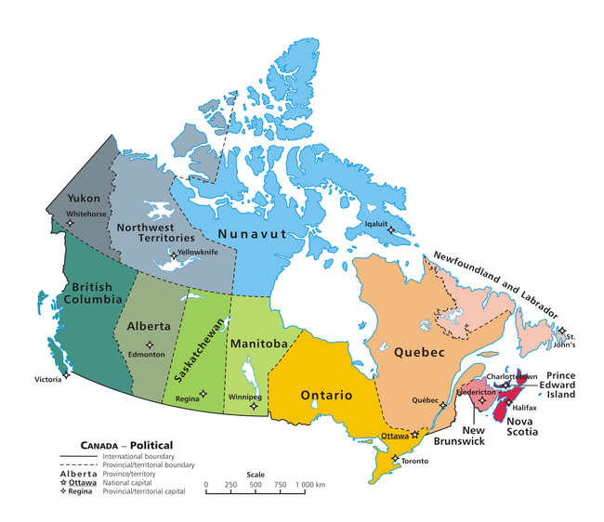
Engineering Professional Associations in Canada
Organized at the provincial level.
Association of Professional Engineers and Geoscientists of British Columbia
Association of Professional Engineers, Geologists and Geophysicists of Alberta
Association of Professional Engineers and Geoscientists of the Province of Manitoba
Northwest Territories and Nunavut Association of Professional Engineers and Geoscientists
Engineers and Geoscientists New Brunswick
Association of Professional Engineers and Geoscientists of Saskatchewan
Engineers Nova Scotia
Engineers PEI
Association of Professional Engineers of Yukon
Ordre des ingénieurs du Québec
Professional Engineers and Geoscientists of Newfoundland and Labrador
Professional Engineers Ontario

Slide 8
Engineering Associations in Canada
Two fundamental differences from organization in USA
Engineering professions are ‘self-regulating’: Each province or territory has passed an Act to create an association of engineers that regulates the profession.
License gives the engineer to practice engineering and bear the title of professional engineer.

Slide 9
History of Professions in Quebec
Initially inspired by European models of regulation
Before 1970
Professional associations had weak social contracts and were non-standardized.
Liberal Professional – independent and unregulated by governments.
Between 1960-70, there was a surge in many new & different professions.

Slide 10

Quiet Revolution in Quebec
1960-70 was a period of immense social, political transformation.
Transformation from a conservative society to a progressive, modern society
Massive state intervention in the affairs of society
Health, education and social sector reform
Nationalization of electricity
Network of state universities

Slide 11
Professional Reorganization in Quebec
In 1970, the Castonguay-Nepveu Commission examined the health system in Quebec.
It recommended change in the professional system in Quebec
It recommended organizational change to make it appropriate for new social and economic conditions
It recommended strong supervisory of government to eliminate inconsistencies in the social contract of professions in Quebec.

Slide 12
Professional System in Quebec
Prior to 1973
Trust in the ability of professional associations to govern themselves
Professional associations were arbitrary
Code of ethics not obligatory
Reason for change
Necessity of ensuring public safety
Development of many specialized professions
Formalizing practice rights

Slide 13
In 1973
National Assembly of Quebec initiated a new control of professional orders
Instituted a Professional System
Adopted the Professional Code

Slide 14
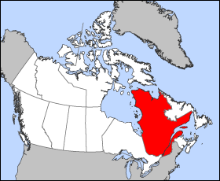
Professional System in Quebec
Unique system of governance of professions in North America
Five primary groups administer the system
The Government of Quebec
Office des professions du Quebec
Quebec Interprofessional Council
Professional Tribunal
46 professional orders

Slide 15
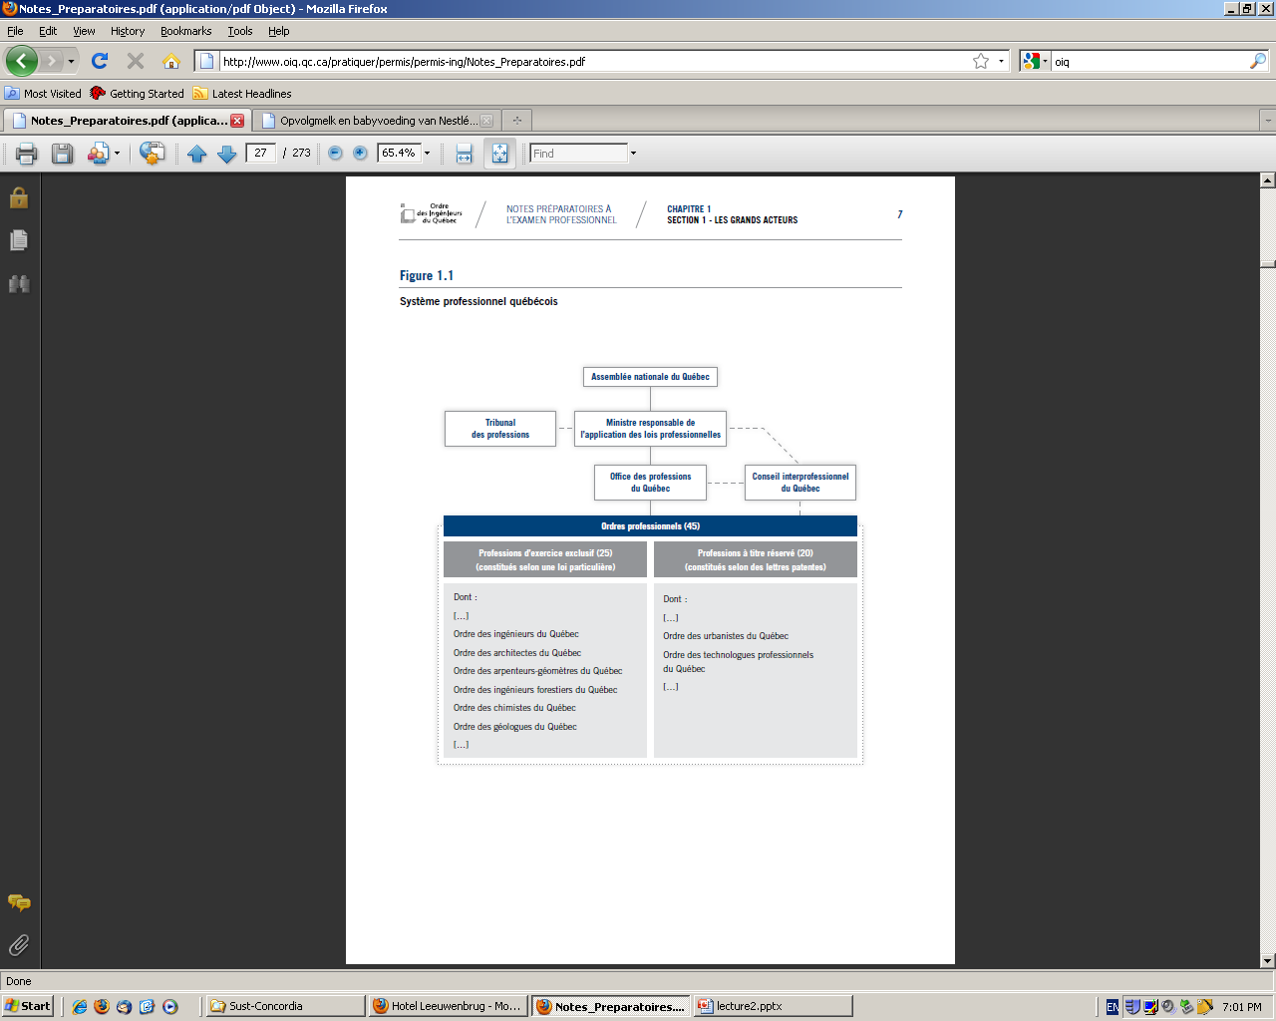
Professional System in Quebec

Slide 16
Government of Quebec (Minister of Justice)
Reports to the National Assembly (NA) of Quebec on the operation of the professional system
The Minister presents legislations and resolutions regarding the professional system in the NA.
Office de Professions du Quebec
Ensures that different Orders respect their mission
Advise the Government of Quebec

Slide 17
Interprofessional Council
Composed of representatives of all 46 Orders
Advisory body that can be consulted on professional matters
Professional Tribunal
Judges appointed by the Court of Quebec
Hears appeals on decisions made by disciplinary councils of different orders

Slide 18
Professionals Orders
Mission of Professional Orders
Ensure Protection of the Public
Two types of Professionals Orders
Professions with Reserved Titles & Exclusive Practice (25)
OIQ
Professions with Reserved Titles (21)
Order of the professional technologists

Slide 19
Reasoning for the professional system
Based on the principle that professions (in Quebec) shall be self-governing, but not completely independent.
Independence: Considerable decision-making autonomy to professional associations;
Transparency: Regulation of professions is open to public scrutiny;
Accountability: Professional system is ultimately answerable to government and people of Quebec
Monitoring: system allows the government of Quebec to exert control

Slide 20
Legal Basis – “The Professional Code”
A Law of public order that reflects the National Assembly’s desire to protect the public in matters concerning professional services.
Applies to all professional orders including OIQ
Creates the Office of Professions and the Interprofessional Council
Creates the different professional orders
Describes the activities of the professional orders

Slide 21
Operation of Professional orders
Creates a Structure of Self-management
Members govern the order by financing,
creating professional regulations, and
creating functions and roles.
Controls practice of profession
Controlling the title and right to practice the profession
Verifying competence and integrity for admission
Maintentance of professional competence
Supervision of professional practice

Slide 22
Operation of Professional Orders
Role
Agent
Leadership & supervision
Training & maintaining competence
Verifies individual competence
Investigates malpractice
Decides on penalties to be awarded
Executive Committee
Training Committee
Inspection Committee
Syndic
Disciplinary Council

Slide 23
Ordre des Ingénieurs du Québec (OIQ)
One of the 46 professional orders in Quebec that are recognized by the Government to regulate themselves.
All engineers in Quebec who engage in professional activities MUST be members of the OIQ.
The rules pertaining to the professional activities of engineers are set out in:
The Professional Code.
The Engineers Act.
The Code of Ethics of Engineers and other regulations.
Bill 101.

Slide 24
Legal basis of OIQ – “Engineers Act”
Defines a member as a person on the roll of OIQ
Defines an engineer as a member of the OIQ.
Defining the field of practice of an engineer
The kinds of work that require an engineer
Defining the kinds of acts that count as engineering practice
Consultation, measurements, design, drawing, inspection
Reserves professional titles

Slide 25
Field of Practice of an Engineer
Railways, public roads, airports, bridges, viaducts, tunnels and the installations connected with transport systems
Dams, canals, harbours, lighthouses
Works of an electrical, mechanical, hydraulic, aeronautical, electronic, thermic, nuclear, metallurgical, geological or mining character and those intended for the utilization of the processes of applied chemistry or physics;
Waterworks, sewer, filtration, purification works to dispose of refuse
Foundations, framework and electrical and mechanical systems of buildings
Structures accessory to engineering works and intended to house them;
Temporary framework and other temporary works used during the carrying out of works of civil engineering;
Soil engineering necessary to elaborate engineering works;
Industrial work or equipment involving public or employee safety.

Slide 26
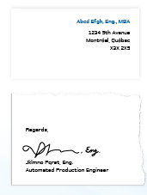
In Quebec, it is against the law to use the title “Engineer” or the abbreviation “Eng.” unless you are a member of the OIQ
Use of the Professional Title

Slide 27
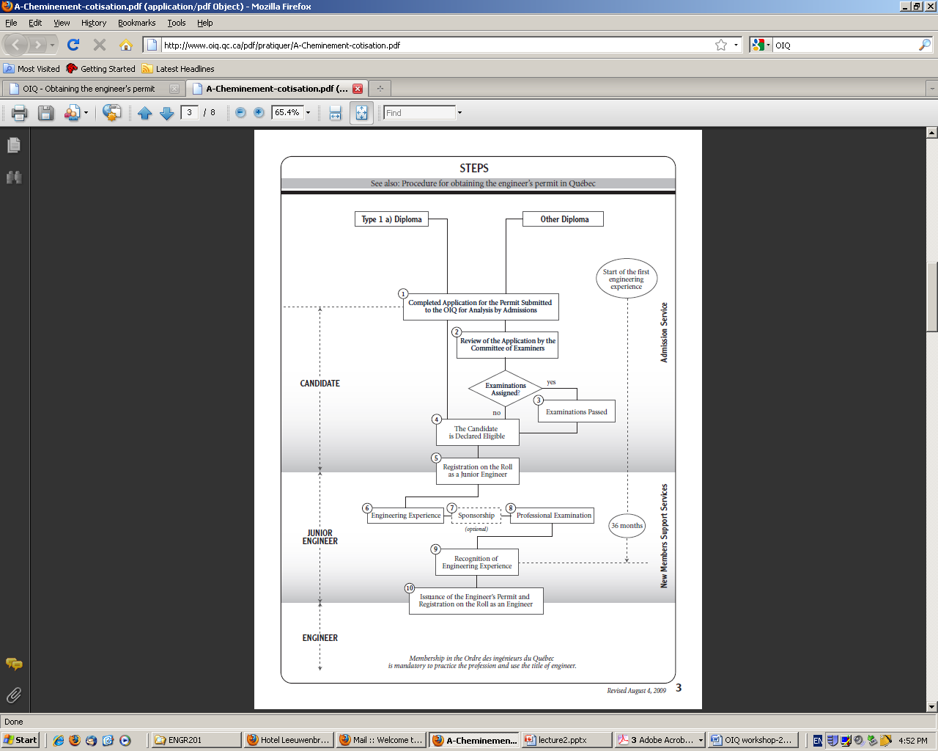

Slide 28
Professional Values
Values that are prized in the profession.
OIQ specifies four values derived from its social mission
Competence
Ethical Conduct
Responsibility
Social Commitment

Slide 29
Ethical Analysis
THAT WILL BE COVERED IN NEXT CLASS ...
THANK YOU!!

